Slide 1
Interrupt Pointer Table
When interrupt occurs, CPU will perform some routine (function)
How to locate the appropriate function or where is the function stored in memory????
In 8086, the interrupt address pointer table is serving as a link between the interrupt type numbers to the locations of their service routines in the program storage memory

Slide 2
Interrupt Pointer Table
For 8086 the table is stored in memory location (address) 00000H – 003FFH (1K)
Address pointers identify the starting locations of their service routines in program memory for the 8086, each pointer requires two words (4 bytes).
Since 4-bytes are required for storing starting addresses of ISPs, the table can hold 256 Interrupt procedures.
The higher address word is the base address and will be loaded into the CS register.
The lower address word is the offset address and loaded into the IP register.

Slide 3
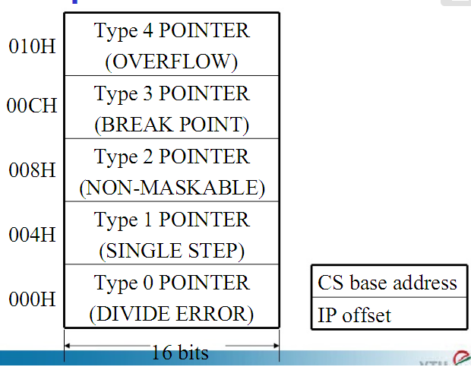
Interrupt Pointer Table
Specific Interrupt

Slide 4
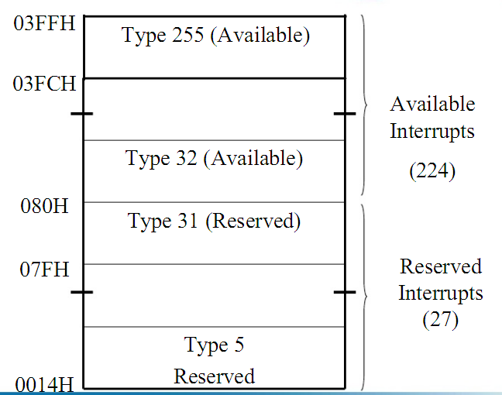
Interrupt Pointer Table

Slide 5
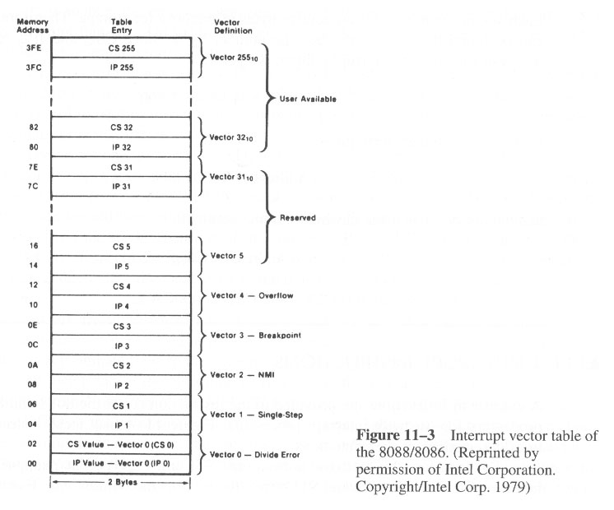
Interrupt Pointer Table

Slide 6
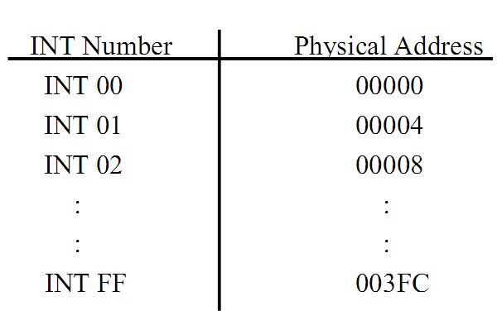
Interrupt Pointer Table

Slide 7
Interrupt Pointer Table
The starting address of an interrupt-service procedure is called the interrupt vector or interrupt pointer.
The table is referred to as the interrupt vector table or interrupt pointer table.
The vector for each interrupt type requires four memory locations.
When the 8086 responds to a particular type interrupt, it automatically multiplies the type by 4 to produce the desired address in the interrupt vector table.

Slide 8
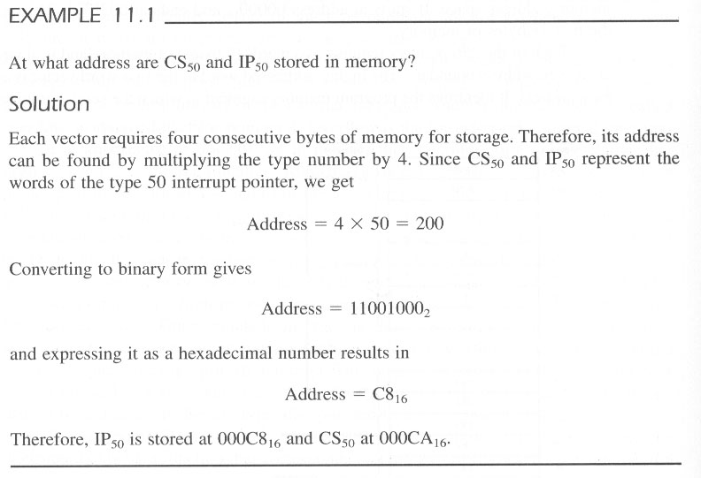
Example

Slide 9
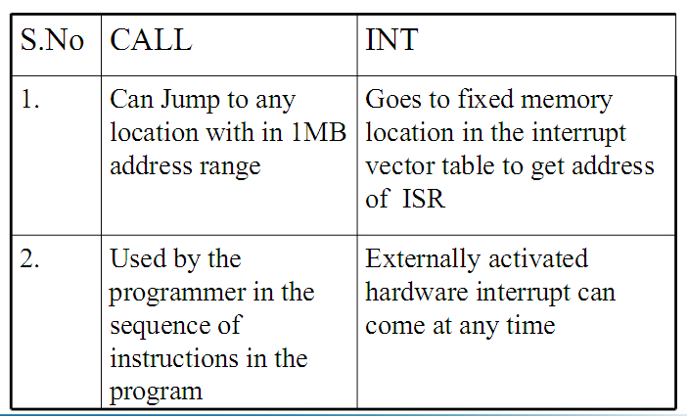
Difference between INT and CALL

Slide 10
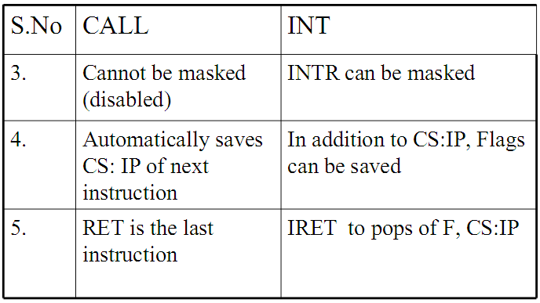
Difference between INT and CALL

Slide 11
Divide-by-zero interrupt – Type 0
8086 will automatically do a type – 0 interrupt if
The result of a DIV operation or
An IDIV operation is too large to fit in the destination register
🡪 Too large!? Infinity!

Slide 12
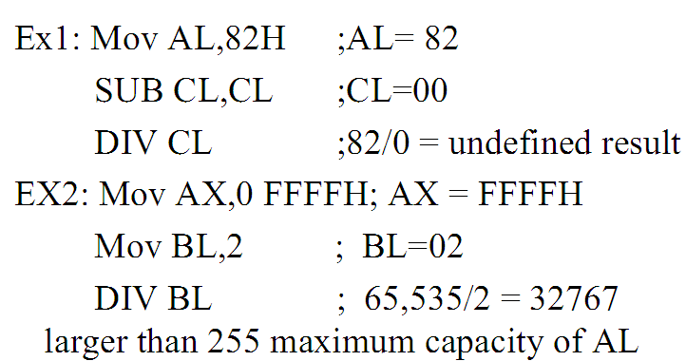
Example of Divide-by-zero interrupt – Type 0

Slide 13
Single Step Interrupt – Type 1
Single step interrupt.
Primarily used for debugging purposes in assembly language.
Execute one instruction and stop. Helps to examine the contents of registers and memory locations.
In single step mode, a system will stop after it executes each instructions and wait for further direction from user.

Slide 14
Single Step Interrupt – Type 1
The 8086 has no instruction to set or reset the trap flag.
These operation are done by pushing the flag register on the stack, changing the trap flag bit and then popping the flag register back off the stack.
Here is the instruction sequence.
To reset the trap flag :
AND WORD PTR[BP+0],0FEFFH
PUSHF MOV BP,SP OR WORD PTR[BP+0],01000H POPF

Slide 15
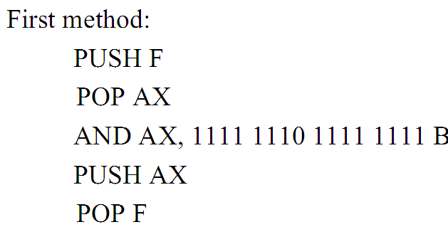
Another Example of Resetting TF (TF=0)

Slide 16
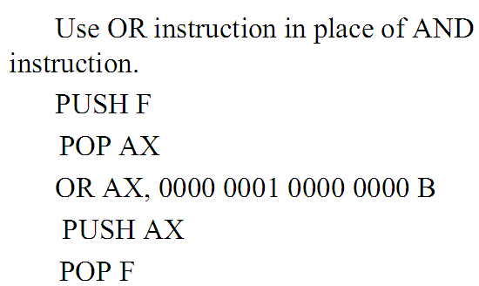
Setting TF (TF=0)

Slide 17
Nonmaskable Interrupt – Type 2
8086 will automatically do a type 2 interrupt response when – it received a low-to-high [0 to 1] transition on its NMI input pin.
Nonmaskable? – maskable = disable

Slide 18
Nonmaskable Interrupt – Type 2
This interrupt can not be disabled/masked – by any program instructions.
As this input cant be intentionally or accidentally disabled, external system must be taken care of.

Slide 19
Example of NMI
We could have a pressure sensor on a large steam boiler – connected to the NMI input.
If the pressure goes above a preset limit, the sensor will send an interrupt signal to the 8086.
Type 2 interrupt-service procedure for this case might
turn off the fuel to the boiler
open a pressure-relief valve and
sound an alarm!

Slide 20
Another example
To save program data in case of a system power failure.
When AC power fails – some external circuitry detects it.
Sends an interrupt signal to the NMI input pin.
Because of the large filter capacitors in most power supplied, the dc system power will remain for perhaps 50ms – after the AC power is gone.

Slide 21
Another Example Contd…
This is enough time for a type 2 interrupt-service procedure to copy program data to some RAM, which has a battery backup power supply.
When the AC power returns, program data can be restored from the battery-backed RAM,
and the program can resume execution where it left off.

Slide 22
Breakpoint Interrupt – Type 3
Produced by the execution of the INT 3 instruction.
Main use is to implement a breakpoint function in a system.
When a breakpoint is inserted in a system, the system executes the instructions up to the breakpoint and then goes to the breakpoint procedure.

Slide 23
Overflow Interrupt - Type 4
Overflow interrupts is generally existent after an arithmetic operation was performed.
The overflow flag ( OF ) will be set if the signed result of an arithmetic operation on two signed numbers is too large to be represented in the destination register or memory location.

Slide 24
Overflow Interrupt - Type 4
Two major ways to detect and respond to an overflow error in a program.
Put the Jump if Overflow instruction (JO), immediately after the arithmetic instruction.
Put the Interrupt on Overflow instruction (INTO), immediately after the arithmetic instruction in the program.

Slide 25
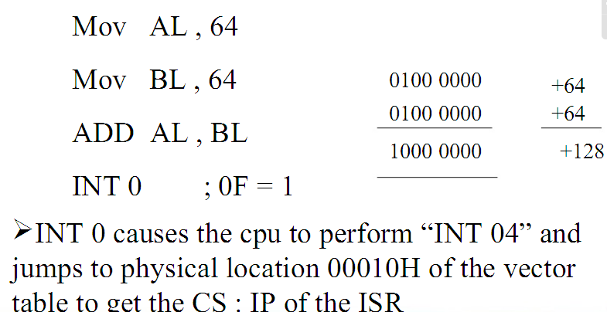
Example of Overflow Interrupt - Type 4

Slide 26
Other Interrupts
Type 5 to type 31 interrupts are reserved by the Intel for more complex microprocessor such as 80286, 80386 and 80486.
The upper 224 interrupt types, from 32 to 255 are available for user to use for hardware and software interrupts.

Slide 27
Software Interrupt Types 0 Through 255
256 software interrupts (0 to 255).
Usage INT n , n is the interrupt type number.
The instruction INT 32 will cause the 8086 to do a type 32 interrupt response.
The 8086 will push the flag registers on the stack, reset TF and IF, and push the CF and IP values of the next instruction on the stack.
CS and IP values for the start of the interrupt service procedure retrieved from the interrupt vector table in memory.
The IP value for any interrupt type is always at an address of 4 times the interrupt type.
CS value is at a location two addresses higher.

Slide 28
INTR Interrupt Types 0 Through 255
8086 INTR input allows some external signal to interrupt execution of a program.
INTR can be masked (disabled) so that it can not cause an interrupt.
If the interrupt flag is cleared, then INTR input is disabled.
IF can be cleared with the Clear Interrupt instruction, CLI.
IF can be set with the Set Interrupt instruction, STI.

Slide 29
INTR Interrupt Types 0 through 255
Before the 8086 can respond to an interrupt signal on its INTR input, IF must be set with the STI instruction.
This allows the 8086, ready to handle interrupts before letting an interrupt in.

Slide 30
INTR Interrupt Types 0 Through 255
The interrupt flag (IF) is automatically cleared as part of the response of an 8086 to an interrupt.
This is done for two reasons.
First : It prevents a signal on the INTR input from interrupting a higher priority interrupt-service procedure in progress.
Second : To make sure that a signal on the INTR input does not cause the 8086 to interrupt itself continuously.

Slide 31
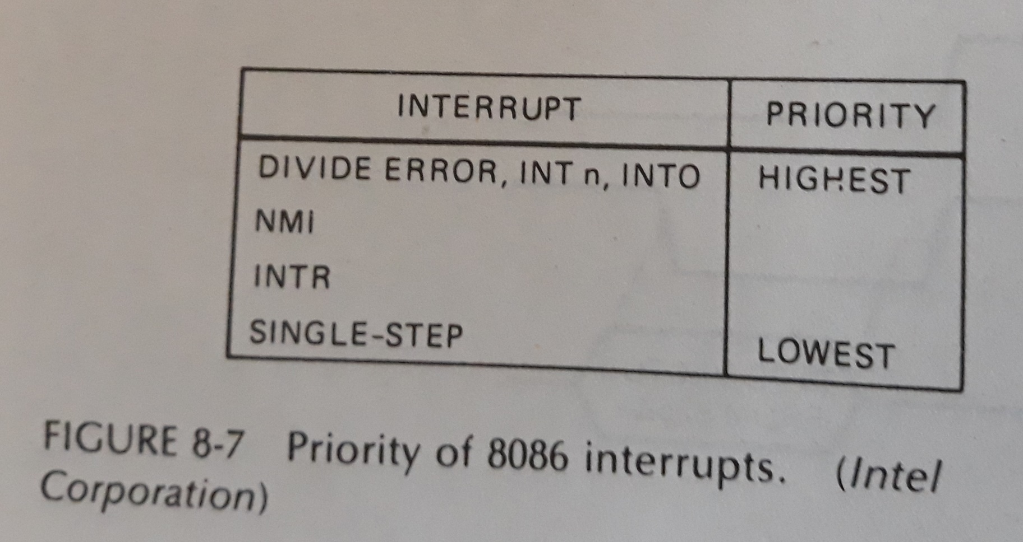
Priority of 8086 Interrupts

Slide 32
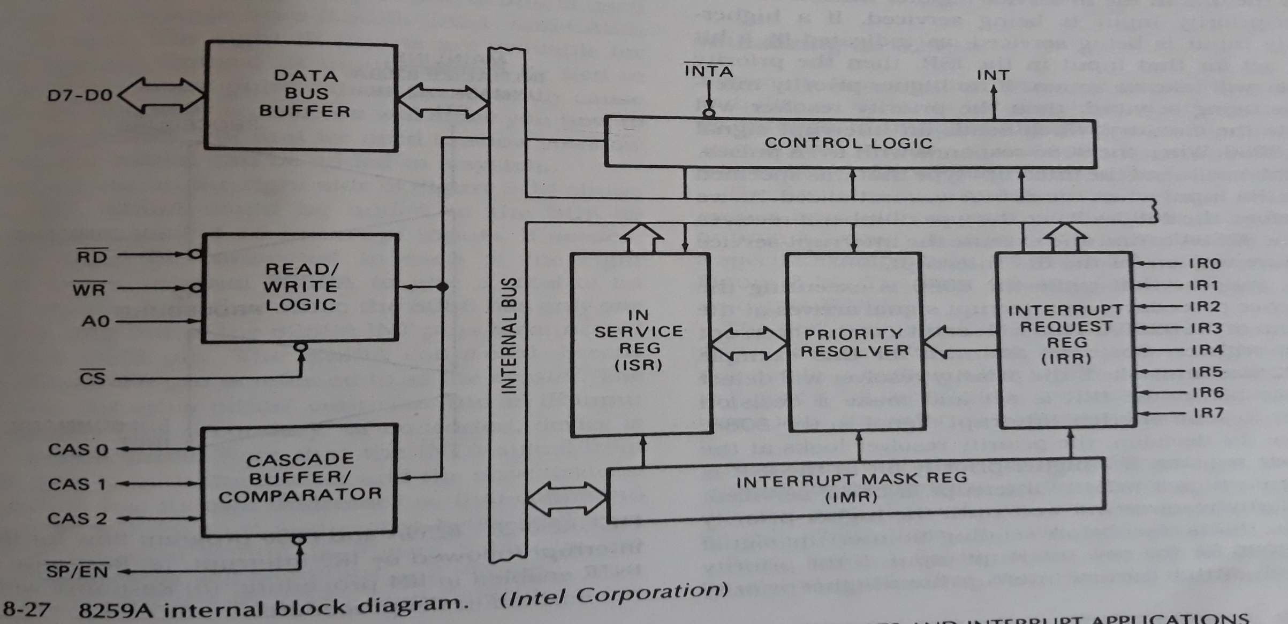
8259A Priority Interrupt Controller

Slide 33
Priority Handling
IR0 input has the highest priority
IR1 input has the second highest priority
Similarly….

Slide 34
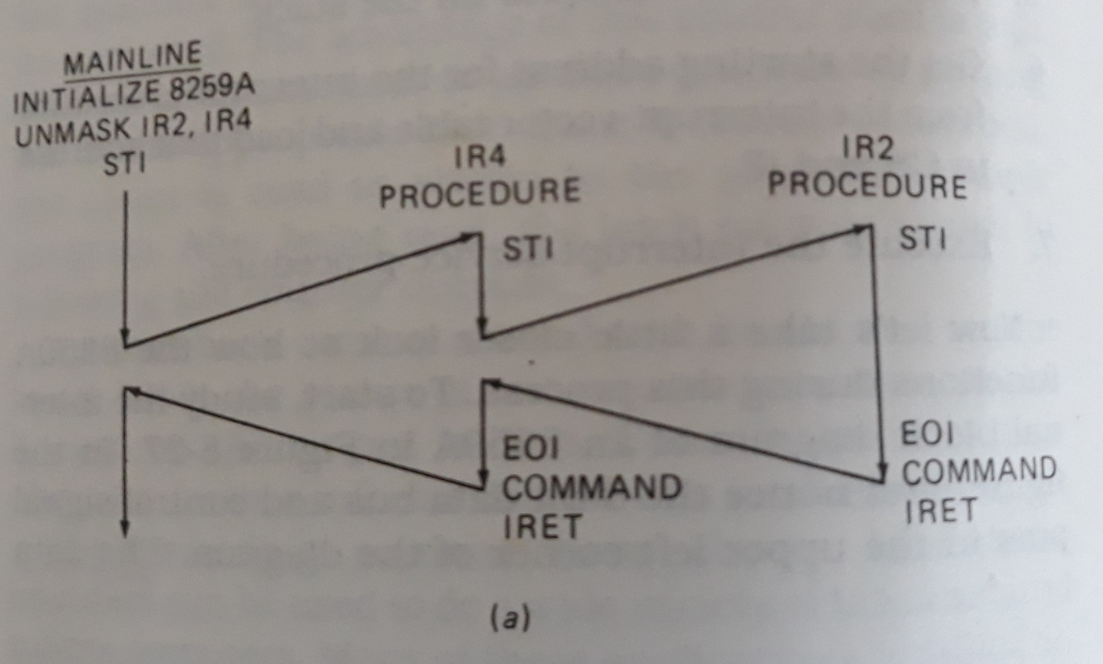

Slide 35
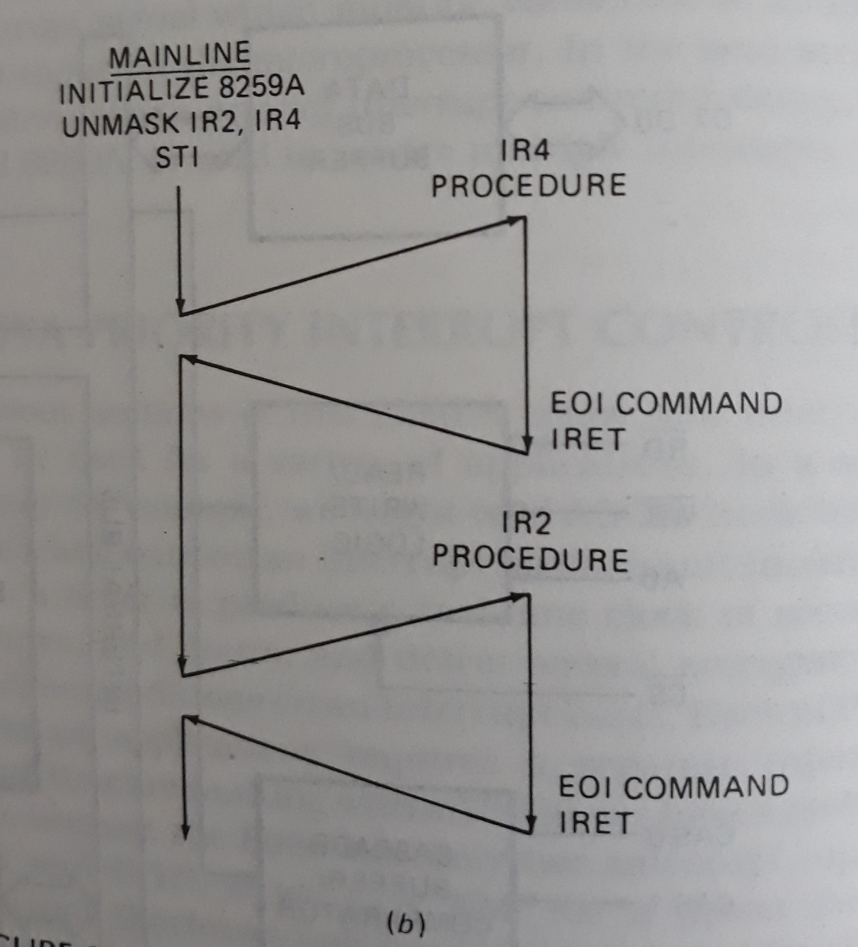

Slide 36
